Slide 1

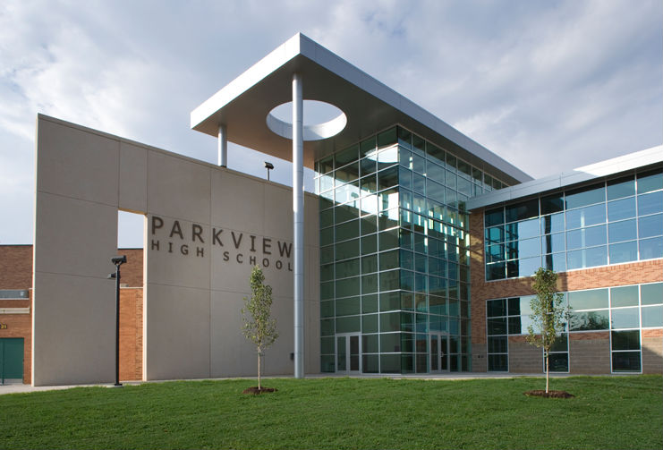
Parkview High School
Scheduling 2022-2023

Slide 2

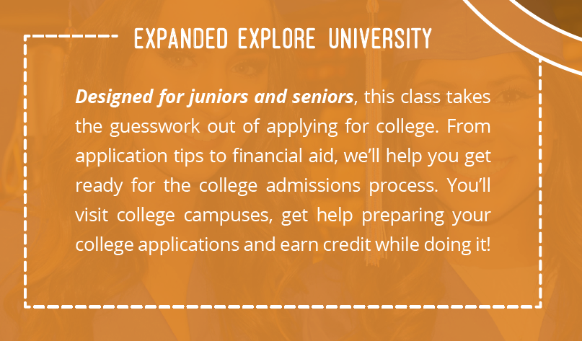
Parkview High School
There will be two sessions of courses…
Session #1: June 6 – June 30 (1 credit)
Session #2: July 5 – July 29 (1 credit)
Explore classes will be online classes
Register TBA
More details to come

Slide 3

Parkview High School
2022-2023 Summer Reminders
Summer ACT Options
June 11/12, 2022
July 16/17, 2022
Explore University
½ Credit Practical Art
6 College Tours in 4 Weeks
Get Ahead On Transition To College
Free
Boys State and Girls State, more info TBA
Upward Bound: first generation
highly motivated, low income, jump start on
classes for Fall, Free

Slide 4
Parkview High School
Advanced Placement (AP) Information
Earn College Credit at PHS!!!
PHS offers the following AP Classes:
English: AP English Lit in 2023
Math: AP Calculus, AP Stats & AP Computer Science Principles
Science: AP Chemistry, AP Biology, AP Physics
History: AP Government, AP World History,
AP US History, AP Psychology, AP European History
Fine Art: AP Music Theory
Additional AP classes available via Launch
College credit is earned based on the AP test

Slide 5
Parkview High School
Advanced Placement (AP) Information
Why take AP?
Smaller class sizes than on college campus
AP Level courses prepare students for the AP Subject test
Free AP testing for students on Free/Reduced Lunch, which you are expected to take
AP testing can qualify you for college credit for free
AP tests are $90, cheaper than dual credit, financial aid available for full pay lunch students
AP is recognized at most colleges
AP courses look good on college applications and scholarship applications
AP Study Skills available for any student taking AP, some students will be required to take Study Skills

Slide 6
COST ANALYSIS
2 Dual Credit Classes x $210 for class = $420.
3 AP Classes x $90 per each test = $270
  Total for 5 classes or 15 credit hours = $690
15 credit hours at Missouri State University is nearly $8,000

Slide 7


Parkview High School
Dual Credit Courses
Earn College Credit at PHS!!!
Over 60 hours of dual credit courses available
Smaller class sizes than on college campuses
Cost of Dual Credit courses is significantly less than the same course in college
MSU offers Free/Reduced Lunch Scholarship = 6 credit hours free/semester, transferrable credit
Current cost per credit hour is $70

Slide 8

Dual Credit Classes at Parkview
Go to the Counseling page of the Parkview website and click on the link that says Dual credit Dual Credit Link

Slide 9

Parkview High School
Leadership 201
  A semester course that requires applying the skills learned from Leadership 101 in a Project Based Learning Setting
  Completion of 10 community service hours is required
  Course prerequisite is an A or B in Leadership 101
  Junior students may take this course first semester
Leadership 301
  A semester course that enhances problem solving skills in the areas of ethical decisions, collaboration, and fostering relationships with team members
  Completion of 15 community service hours is required
  Course prerequisite is an A or B in Leadership 201
Leadership 401
  Course prerequisite is an A or B in Leadership 301
  Capstone Project
  Dual Credit Course

Slide 10



Parkview High School
SPS Choice Programs
OTC Career Center
20 Strands (See Selection of Studies) in AM or PM
Earn up to 40 college credit hours in 2 years
OTC Middle College
20 Strands
Junior and/or Senior years spent on OTC’s campus
GO CAPS
Three Strands:
Health Care, Business, Engineering & Manufacturing
Educational experiences in the workforce setting,
Flyers in the Counseling office

Slide 11
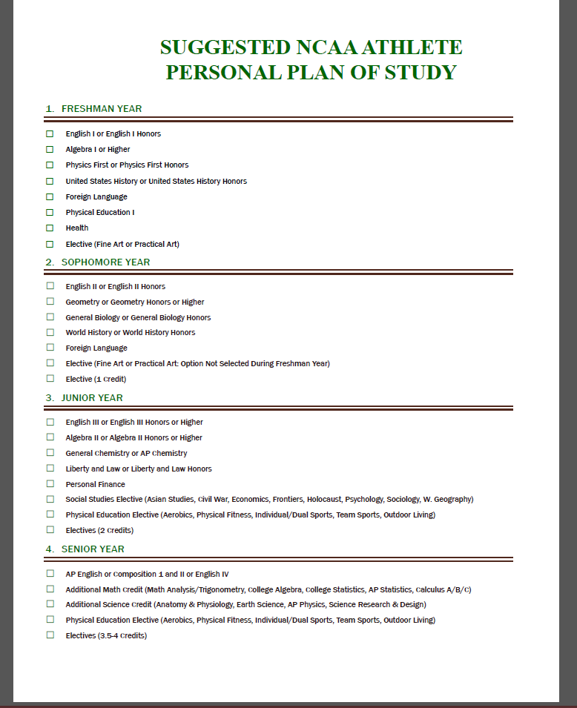
Parkview High School
NCAA Eligibility

Slide 12
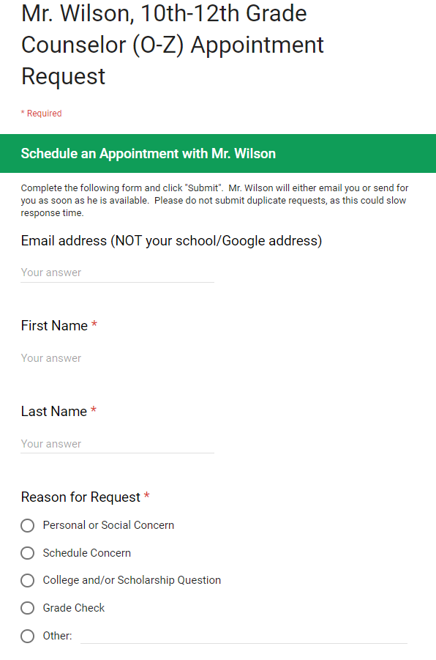
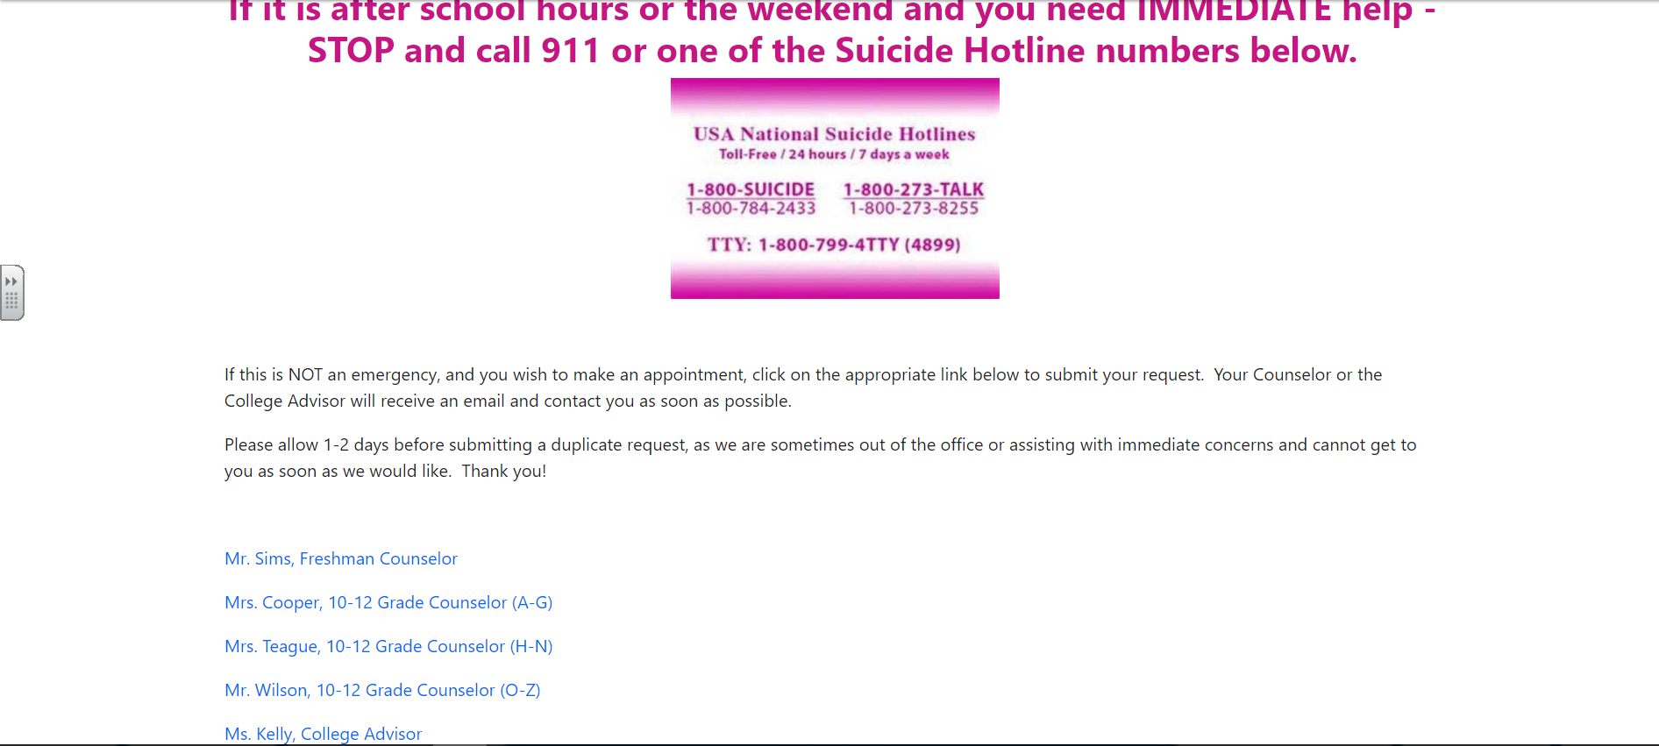
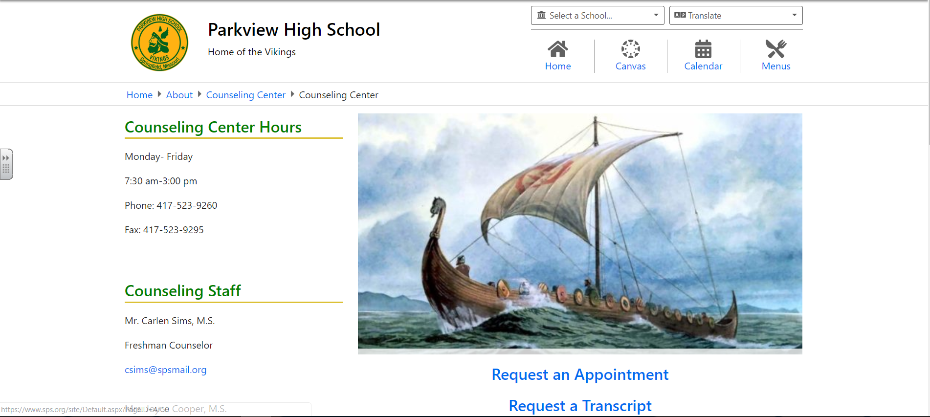
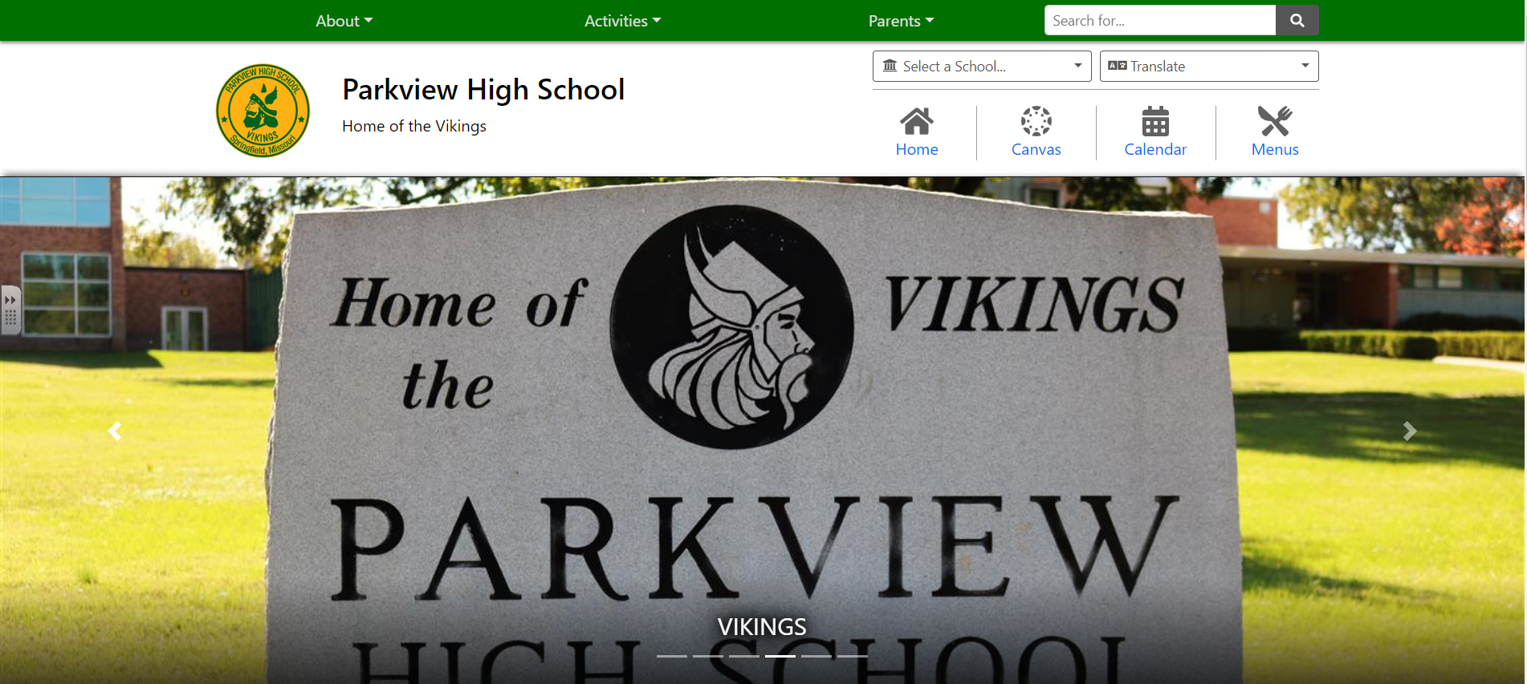
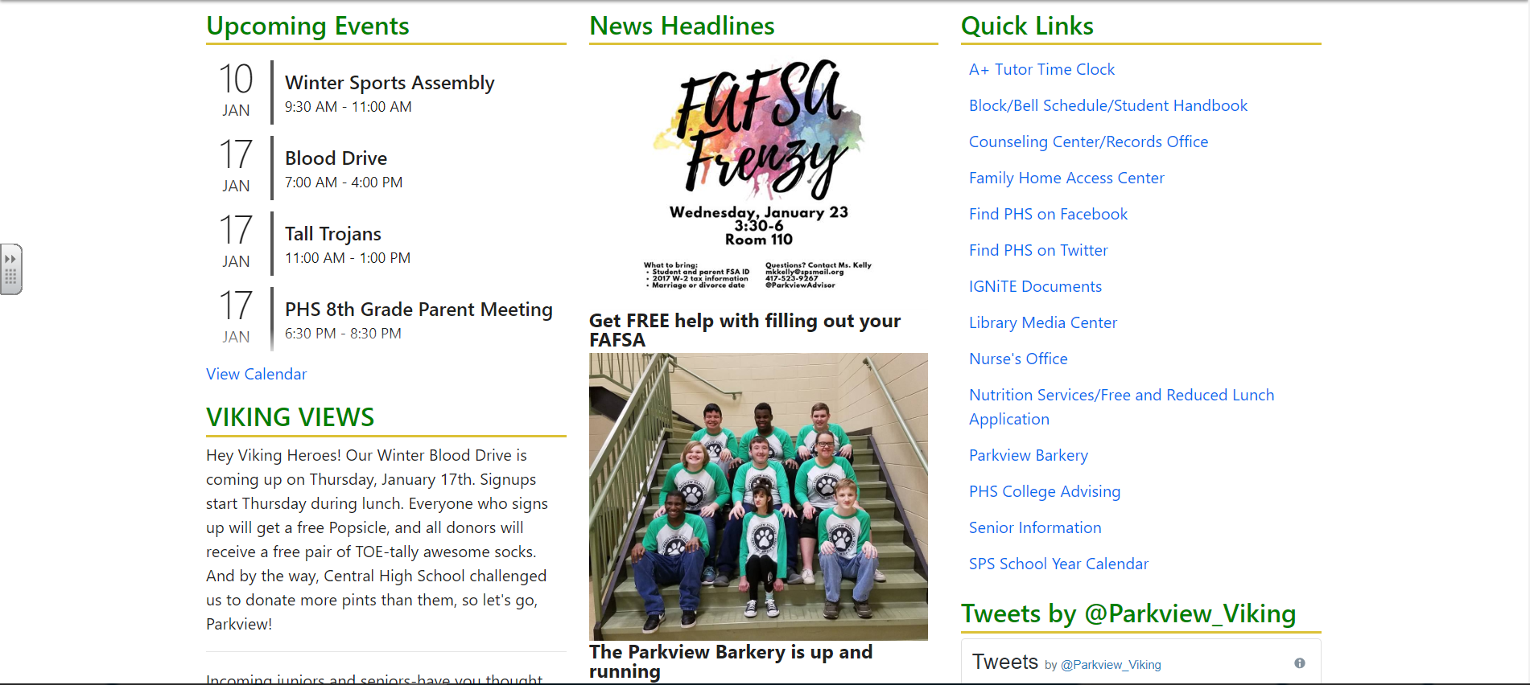
Parkview High School
Questions? Contact Your Counselor

Slide 13


Parkview High School
Failure to complete ICAP Course Selection form will result in your counselor creating your 2022-23 schedule. Any schedule change requests will be at the discretion of PHS administrators!

Slide 14
Classes missing on the course request papers
AVID III
PLTW: Principles of Engineering, the next class after PLTW: Intro to Engineering (prerequisite)

Slide 15
Completing the ICAP Form
Take out your transcript or open a tab in e-school with your transcript
Go to Counseling Canvas Page
Go to Modules ICAP
Open the one that says ICAP form
Rename copy of ICAP, your name ICAP form
Share ICAP with your counselor
  jlcooper@sps.org Last names A-G
  krteague@sps.org Last names H-N
  jwilson@sps.org Last names O-Z
Wait for more instructions, we will do this together

Slide 16
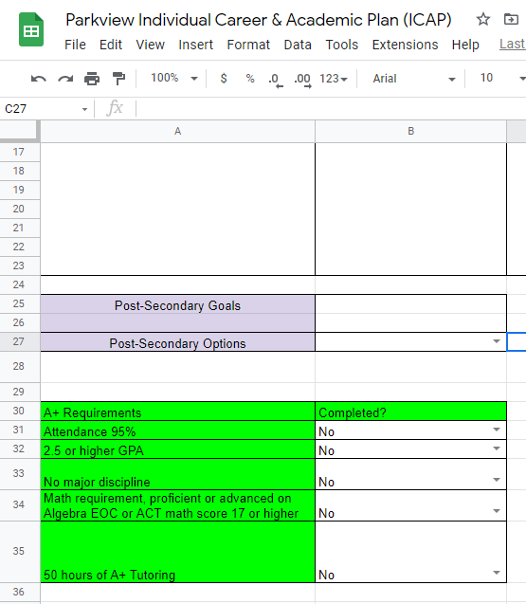
A+ Scholarship Info, page 2 of ICAP
2.5 GPA, about ½ B’s & ½ C’s
95% Attendance
50 hours Tutoring
College Readiness requirement –
Algebra EOC, proficient or advanced
or qualifying math ACT sub-score
Good Citizenship – no major discipline, on Status report says A+ eligible
Two Years Free at OTC or any community college in Missouri, worth over $10,000

Slide 17
Other Certifications you can earn, ICAP page 2
NCAA/NAIA, talk to coaches for info
Industry Recognized Credential, OTC program
Technical Skills Assessment, FACS teachers info
Career & Technical Education Skill Certificate
Seal of Biliteracy, talk to your foreign language teacher for info
Seals of Excellence requirements
College Preparatory Studies Certificate requirements

Slide 18
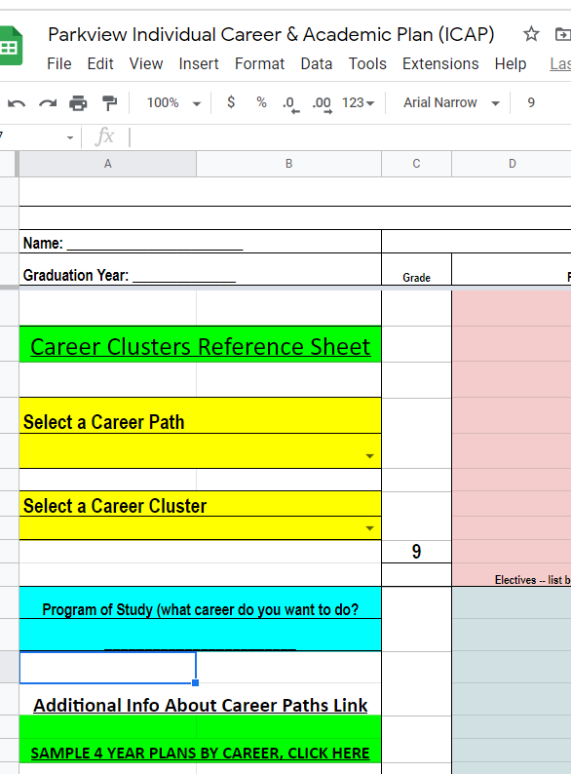
Use the sample plans for ideas, and replace the electives with the ones you want.
Selecting a Career Path and Career : Remember you are not locked into this choice, it is just a reference point to help you plan classes.
Refer to the Career Cluster Reference link:
Select a Career Path from the dropdown:
Select a Career Cluster, from the dropdown list.
Type in the career you want to do in the Blue box.

Slide 19
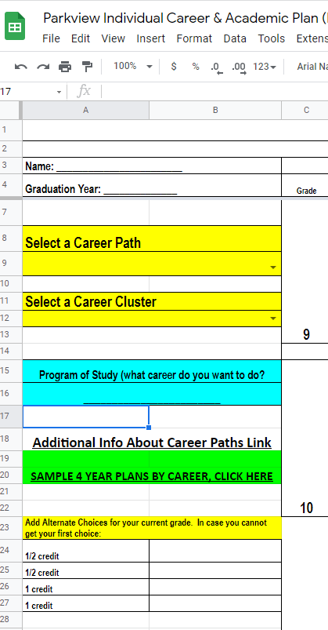
Parkview High School
2022-23 Alternate Courses
Select alternate classes left column
Sometimes elective classes fill and another course will need to be substituted.
If you apply for OTC or GO CAPS, put OTC or GO CAPS in the Alternates and select courses.
List TWO 0.5 credit courses and TWO 1.0 credit courses in order of preference.
It is very important that you list these alternate courses.

Slide 20
4 Year Plan:
First, add classes from your transcript then add
Classes required to graduate completing 25 units of credit in the following areas…
Communication Arts 4.0 Fine Art 1.0
(i.e. art, vocal or
Mathematics 3.0 instrumental music, drama)
Social Studies 2.5 Practical Art 1.0
(i.e. Business, Computer,
Liberty and Law 0.5 Industrial Technology, Family and Consumer Science) Science 3.0
Personal Finance 0.5
Physical Education 1.5
Health 0.5
Electives to bring the total to 25
Points To Remember
College Bound Students Are Recommended to Take 4 Credits of Each Core Subject
Some Colleges and Universities Require 2 Years of the Same Foreign Language
4-5-5-4 – Weighted classes for Top 10

Slide 21
Print your completed form
Take it home to be signed by Parent/Guardian on the line by your current grade.
BRING IT BACK SIGNED AND COMPLETED on ______________. About one week from today.

Slide 22
THANK YOU!
  THE PHS COUNSELING STAFF
Parkview High School

